Slide 1

House Price Prediction
Muhammad Abubakar Saddique

Slide 2

Introduction
House price prediction is an important aspect of the real estate market, as it helps to determine the value of a property. Accurate predictions can help buyers, sellers, and investors make informed decisions.

Slide 3

Problem Statement
Our Problem Statement is to analyse the dataset of properties in Lahore and then building a model to predict its price using location, Area(Sq. Ft), bedrooms, baths.

Slide 4

Data Collection
The dataset is taken from Kaggle (Zameen.pk-2021).
It has 17 Columns.
Target features are location, Area, bedrooms, baths and price.

Slide 5
Data Pre-Processing
Sub-setting data to Lahore city.
Dropping all rows with property_type other than House.
Dropping extra columns (giving less consideration)
Data Cleaning (Baths & Bedroom Case I & II)
Converting Area from Marla & Canal to Square foot
Finding Price_Per_Sqft
Dropping Locations having less then 10 properties
Dropping rows having rooms with area less then 300 sqft
Dropping those rows having less rooms but more price than others.
Creating a new DataFrame with binary columns for each unique value in the specified Location.

Slide 6
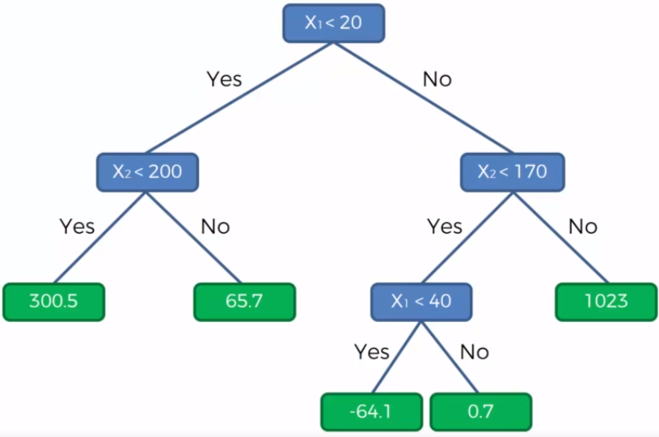
Model Development
Decision tree regressor model works by dividing the data into subsets based on the input features and using the average house price in each subset as the prediction for all houses in that subset. This results in a series of decision rules that map the input features to predicted house prices.

Slide 7
Linear Vs Decision Tree Regressor

Slide 8
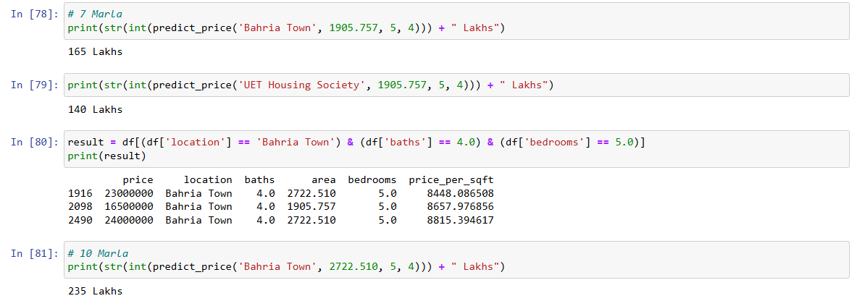
Results and Evaluation

Slide 9

Conclusion
Decision trees are one of the most widely-used machine learning models, due to the fact that they work well with noisy or missing data
It can easily be ensembled to form more robust predictors.
One more reason behind splitting in decision tree is it gives us more accurate results.

Slide 10
Future Plans
Consider adding new features that may be relevant to the prediction.
Explore the use of deep learning techniques, such as neural networks, for house price prediction, and compare the results with the decision tree regressor model.
Test the model in different real estate markets to determine its generalizability and adaptability to different conditions.

